Slide 1
s
O
O
O

Slide 2
s
O
O
O

Slide 3
J
O
O
O
O
The Journal of Cutaneous Oncology
Official publication of the Society of Cutaneous Oncology

Slide 4
s
O
O
O

Slide 5
J
O
O
O
The Journal of Cutaneous Oncology
Official publication of the Society of Cutaneous Oncology

Slide 6


The Journal of Cutaneous Oncology
Official publication of the Society of Cutaneous Oncology

Slide 7


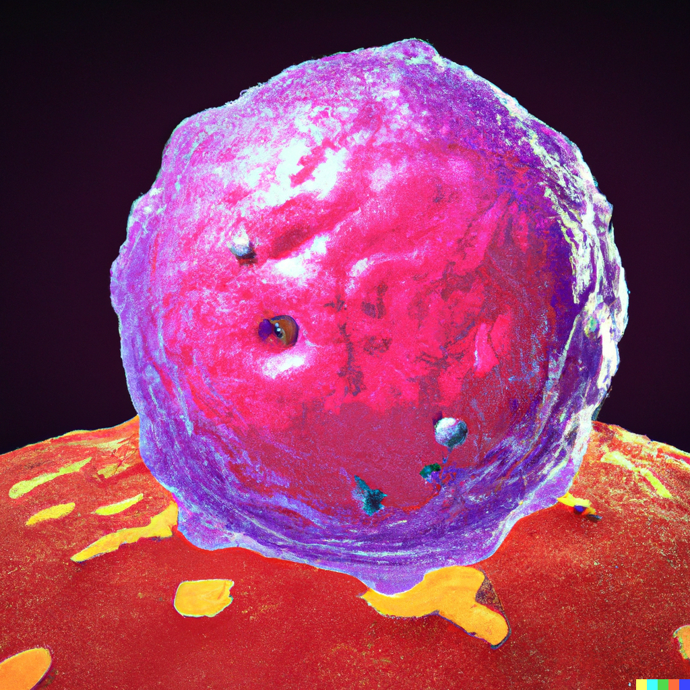
Volume 1, Issue 1
The Journal of Cutaneous Oncology
Official publication of , the Society of Cutaneous Oncology

Slide 8
Volume 1, Issue 1
The Journal of Cutaneous Oncology
Official publication of the Society of Cutaneous Oncology

Slide 9
Volume 1, Issue 1
The Journal of Cutaneous Oncology
Official publication of the Society of Cutaneous Oncology

Slide 10
Volume 1, Issue 1
The Journal of Cutaneous Oncology
Official publication of the Society of Cutaneous Oncology

Slide 11


Slide 12

Volume 1, Issue 1
The Journal of Cutaneous Oncology
Official publication of the Society of Cutaneous Oncology

